Slide 1

Lecture 1
Math Foundations Team

Slide 2
Course Over View
Modules:
Matrices and Solving System of Linear Equations
Vectors, Distance and Angle between vectors, Linear Independence and Dependence
Matrix Decompositions
Vector Calculus
Gradient Descent Algorithms, Challenges in optimization in ML
Optimization in Machine Learning (PCA, SVM)

Slide 3
Why do we study Vectors and Matrices
Vectors are fundamental in machine learning (ML) and are used throughout the entire workflow, from data representation to model training and prediction. Here's a breakdown of how vectors are used in ML:
Data Representation:
(a) Feature representation(A house can be described by the features:(House number, No of Bed rooms, Area in square feet) = (133, 4, 2200)
(b) Text as Vectors: In ML texts are represented as vectors. There are techniques such as Word2Vec, BERT embeddings, etc that convert words or text into vectors.
2. Distance and Similarity:
The distance between vectors is defined using inner product (also known as dot product) and this notion is used to study the similarity of the data.
3. Linear dependency and Data Redundancy: We study linear independent and linear dependent vectors. If two vectors are linearly dependent then we conclude that one of the data is redundant of the another.

Slide 4
What is linear algebra?
Linear algebra is the study of vectors and rules to manipulate vectors.
Vectors are not only the familiar geometric vectors from high school (points in 2D/3D space) but any special objects which can be added together and multiplied by scalar values to produce another object of the same kind. For example, polynomials can also be treated as vectors.
We shall deal with vectors in the space R^{n}

Slide 5
Systems of linear equations
Systems of linear equations form a central part of linear algebra.
Many problems can be formulated as systems of linear equations.
Tools of linear algebra can be used to solve such problems.
We would use analytical techniques and numerical methods to solve the systems of linear equations.

Slide 6
Motivating problem for studying Linear System of Equations
Consider the following problem.
A company produces products N₁, N₂, ...N_{n} for which resources R₁, R₂, ...R_{m} are required. To produce a unit of product N_{i} , a_{ij} units of resource R_{j} are needed, where 1 ≤ i ≤ n, 1 ≤ j ≤ m. Find an optimal production plan where x_{i} units of product N_{i} are produced if a total b_{j} units of resource R_{j} are available, and no resources are left over.

Slide 7
Formulation
If we produce x₁, x₂, . . . x_{n} units of the products N₁, N₂ . . . N_{n} we need a total of a_{1i}x₁ + a_{2i}x₂ + · · · + a_{ni} x_{n} units of resource R_{j} . Thus we set up the equation:
a_{1i}x₁ + a_{2i}x₂ + . . . + a_{ni} x_{n} = b_{i}
We can similarly set up the following set of linear equations in n
unknowns, x₁, x₂ . . . x_{n}.
a₁₁x₁ + a₂₁x₂ + · · · + a_{n1}x_{n} = b₁
.
.
a_{1m}x₁ + a_{2m}x₂ + . . . + a_{nm}x_{n} = b_{m}
A linear system has zero, one or infinitely many solutions

Slide 8
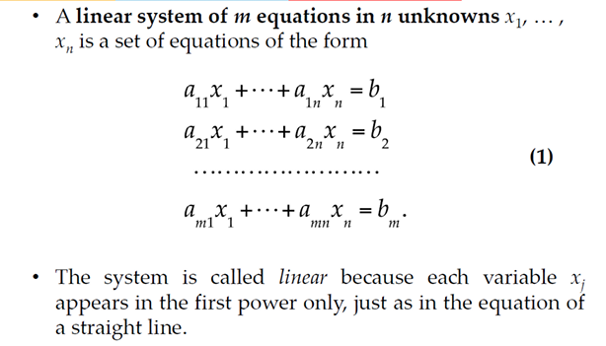
A System of Linear Equations

Slide 9
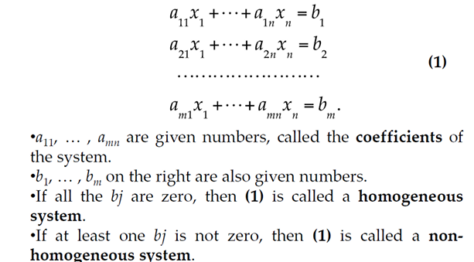
System Of Linear Equations

Slide 10
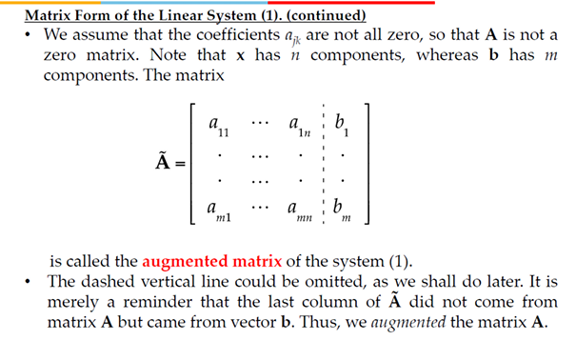
Augmented Matrix

Slide 11
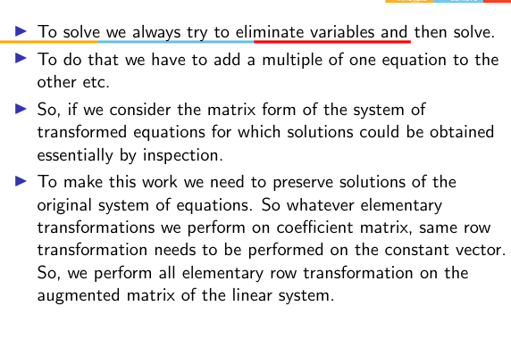
Solving System of Equations

Slide 12
Solving system of linear equationswith two variables and their geometrical interpretation

Slide 13
Three Possibilities
A system of linear equations has
no solution, or
2. exactly one solution, or
3. infinitely many solutions.
A system of linear equations is said to be consistent if it has either one solution or infinitely many solutions; a system is inconsistent if it has no solution

Slide 14
Matrices

Slide 15
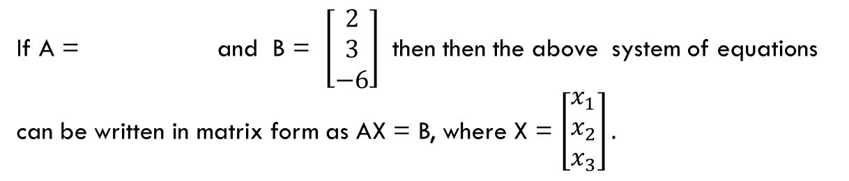
How to represent a system of equations in Matrix form

Slide 16
Example
Solve the system of equations
Augmented Matrix

Slide 19
Echelon Form and Reduced Row Echelon Form
A rectangular matrix is in echelon form (or row echelon form) if it has the following three properties:
All nonzero rows are above any rows of all zeros.
Each leading entry of a row is in a column to the right of the leading entry of the row above it.
All entries in a column below a leading entry are zeros.
If a matrix in echelon form satisfies the following additional conditions, then it is in reduced echelon form (or reduced row echelon form):
4. The leading entry in each nonzero row is 1.
5. Each leading 1 is the only nonzero entry in its column.

Slide 20
Elementary Row operations

Slide 21


Reduced Echelon Form
These matrices are in Reduced Echelon form. Verify.
Which rows have pivot elements?
These matrices are in echelon form but not in reduced echelon form. Why?
These matrices are not in echelon form. Why?

Slide 22
Gauss-Jordan Elimination Method - Example
Solve the system of equations

Slide 23
Example Ctd

Slide 24
Example Ctd

Slide 25
System of Equations with no solution
Solve the system of equations if possible

Slide 26
System of Equations with Infinite Number of Solutions
Solve the system of equations
Note that in the final matrix which is reduced echelon form 2nd and 3rd column do not have pivot elements. Those columns correspond to the independent variables. That is x₂ and x₃ are independent variables.
Hence the solutions are x₄ = 2, x₂ = r, x₃ = s and x₁ = -2 -2x₂ + x₃ where r and s are any real numbers.

Slide 27
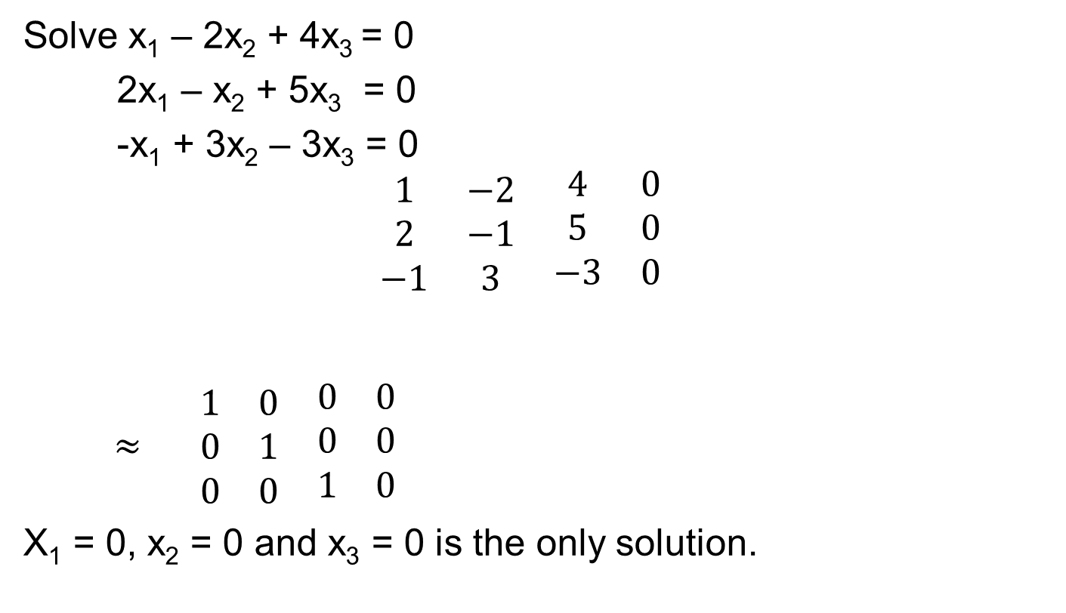
Homogenous System

Slide 28
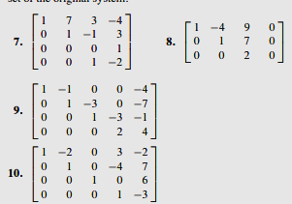
Practice Problems
The augmented matrix of a linear system has been reduced by row operations to the form shown. In each case, continue the appropriate row operations and describe the solution set of the original system.

Slide 29


Practice Problems

Slide 30
You don’t have to compute Reduced Echelon form to solve the system of linear equations. Instead it is enough to find the Echelon form.
The following example explains this method. This method is called Gaussian Elimination method.
HW: Follow this method for the previous examples to solve the system of linear equations.

Slide 31
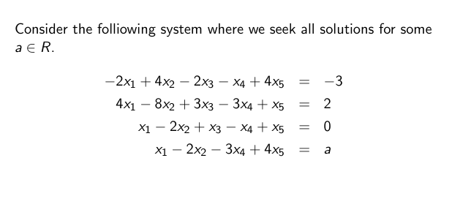
One more Example:

Slide 32
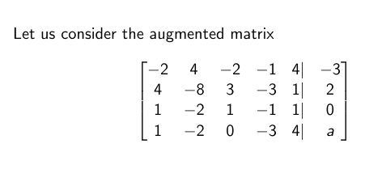

Slide 33
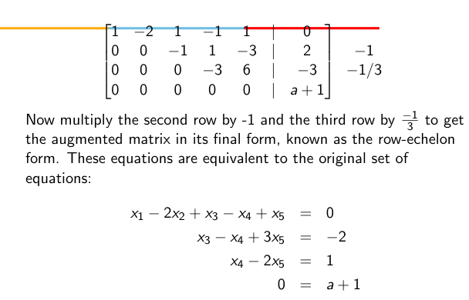

Slide 34
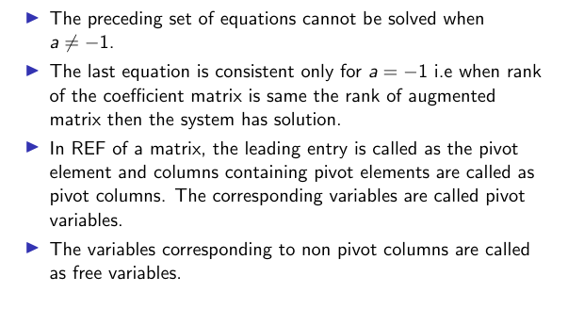

Slide 35
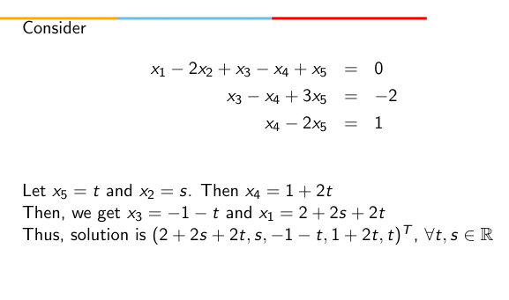

Slide 36
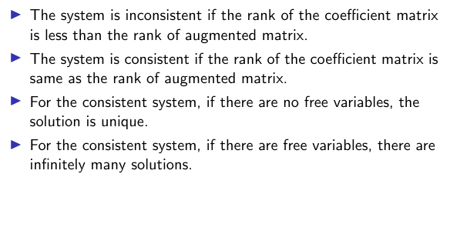

Slide 37
Gaussian elimination and Gauss Jordan
Repeated use of elementary row operations done to convert a matrix to upper triangular form is called Gaussian elimination.
Consider the system of equations Ax = b where A is a n × n
matrix.
If A is invertible, it means that A⁻¹ exists such that
AA⁻¹ = A⁻¹A = I_{n}
In such a case the row-reduced echelon form of A is I_{n}, i.e every column is a pivot column where the pivot is 1.
The process of converting A to I_{n} that we have discussed above is called the Gauss-Jordan method.

Slide 38
Gaussian elimination and Gauss Jordan
In Gaussian Elimination we use multiples of the first row to eliminate the entries in the first column below the first row.
Then we use multiples of the second row to eliminate entries in the second column below the second row and so on until we get an upper-triangular matrix.
This Gauss Jordan process is shown diagramatically in the next slide.
Then we take multiples of the last row to eliminate non-zero entries in the last column above the last entry, followed by multiples of the last but one row to eliminate non-zero entries in the last but one column and so on. This gives us a diagonal matrix.

Slide 39
Calculating inverse
Can the Gauss Jordan procedure calculate the inverse of a matrix?
For example, let A be a n × n matrix whose inverse A⁻¹ exists. We would like to compute its inverse using Gauss Jordan procedure. Is this possible?
Yes we can compute the inverse in the following way: we simply set up n linear systems of the form Ax = e_{i}, 1 ≤ i ≤ n where e_{i} is the i th canonical basis vector and find their solutions x. Each solution vector constitutes a column in A⁻¹. Why is this true?

Slide 40

Find the inverse of A is exists.
Hence inverse of A = $\left[\begin{matrix}0 & 1 & 1 \\ 5 & −3 & −1 \\ −3 & 2 & 1\end{matrix}\right]$

Slide 41
Find the inverse of A if exists.
Since the LHS 3x3 matrix can not be brought to I₃ Inverse of A does not exist.

